Slide 1
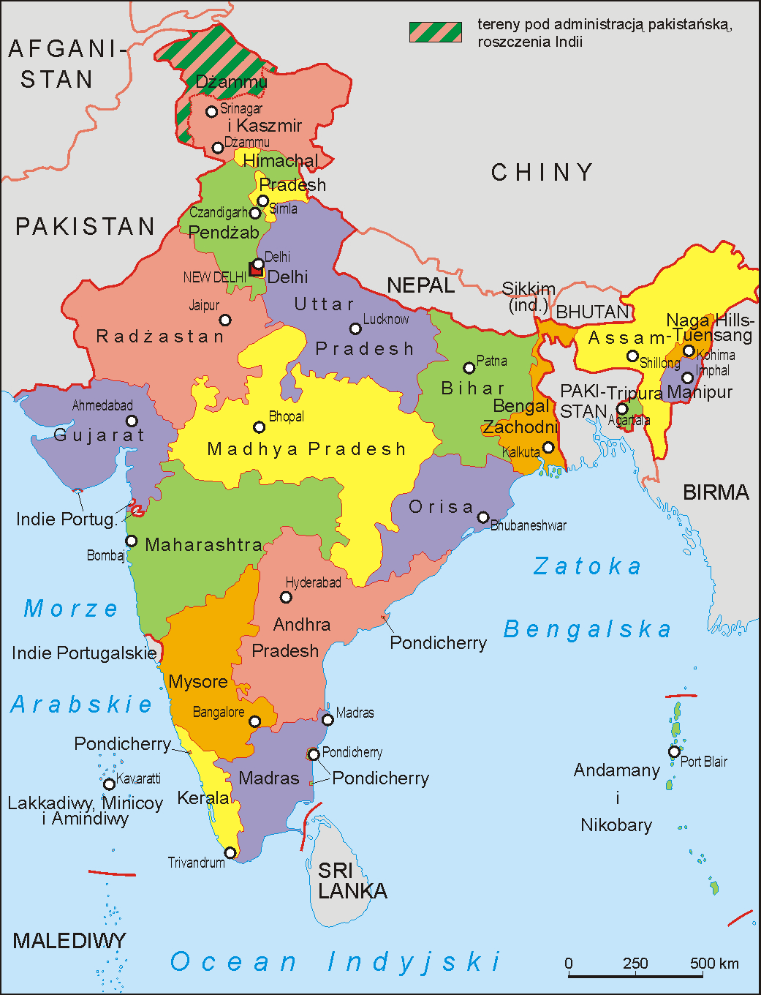
District-Wise Sectorial Analysis of Indian States
This presentation delves into a comprehensive analysis of economic
contributions from three major sectors: Primary, Secondary, and Tertiary,
across various districts in India. It uses SQL to extract valuable insights
and visualize trends over several years.
72 - Harshit Saraf
74 - Jishnu Pramod
78 - Kiran Gaikwad
87 - Poorva Palkar

Slide 2

Company Overview : SKILLMINE
Skillmine Technology Consulting is a leading IT services and consulting company, established in 2011 with headquarters in Mumbai, India.
The company offers a range of technology solutions, including cloud transformation, data science and analytics, cybersecurity, and IT infrastructure services.
With over 1,000 employees, Skillmine has a strong presence in India, the Middle East, the UK, and the America.
Skillmine is known for its comprehensive services like SAP managed services, security operations, and robotic process automation (RPA), helping businesses optimize operations and enhance productivity.
The company also focuses on delivering scalable, innovative solutions in fields such as AI, machine learning, and data management, aligning with global market demands.

Slide 3
TASKS ASSIGNED
1.Data Analysis :
The task involved a detailed examination of a dataset containing contributions from the three major economic sectors across Indian districts.
Consisting of 2250 rows and 12 columns.
2. SQL Query :
Using SQL, data was extracted, filtered, and aggregated to identify patterns and trends in economic performance across different sectors and districts.
3. Data Visualization :
Power BI or Tableau were utilized to visualize the data insights and effectively communicate the trends and economic patterns observed during the analysis.

Slide 4
SQL QUERIES
1. JOIN OPERATION
Write a query to join district data with state codes and names to display state-wise analysis.
2. GROWTH CALCULATION
Calculate the year-on-year growth of the secondary sector for a specific district.
3. TREND ANALYSIS
Identify the district with the highest growth rate in the tertiary sector over a five-year period.
4. RANKING
Rank districts within a state based on their total constant prices for a given year.
5. SUB QUERY
Write a subquery to find the state that contributed the most in the tertiary sector at current prices for a given year.

Slide 5
6. JOIN AND AGGREGATE
Join state and district data and calculate the total economic contribution for a particular state across all its districts for a given year.
7. WINDOW FUNCTIONS
Use a window function to calculate the cumulative total of the primary sector at constant prices for a district over the years.
8. MAX-MIN ANALYSIS
Identify the district with the highest and lowest total current prices for a given year.
And other similar queries were also addressed.

Slide 6
LIMITATIONS
Complex Queries
Complex queries involving multiple conditions may require optimization
Limited Customization on Looker Studio
Customization options are somewhat limited compared to other advanced DV tools
3. Lack of Advanced Analytics
Lacks advanced analytics features like predictive modeling, machine learning integration, and deeper statistical functions
4. Dependency on Google Ecosystem
It supports third-party connectors but those integrations can sometimes be more cumbersome.
5. Limited Data Transformation
Lacks powerful data transformation capabilities.

Slide 7
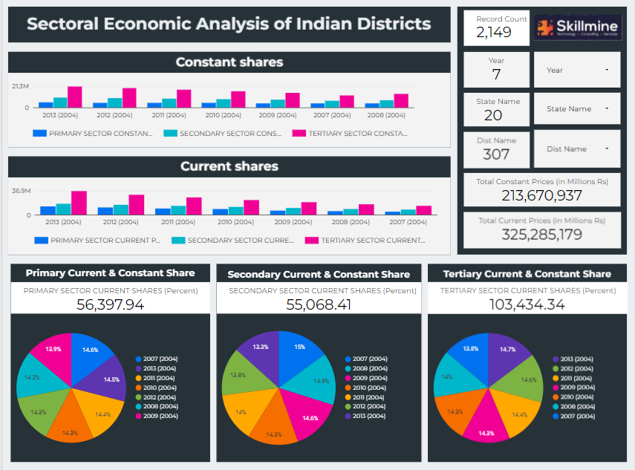
SNAPSHOT OF DASHBOARD
https://lookerstudio.google.com/reporting/51736145-1f22-4270-a5be-73a392515cde

